Slide 1
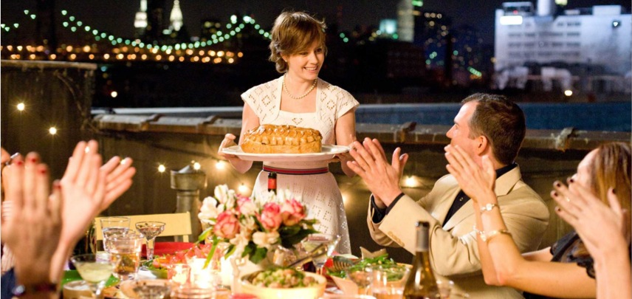
Host a Meal for International Projects

Slide 2
Goal
The Board invites you to host a meal at your home before May 2014 to raise funds for International Projects.
Your aim is to ensure your guests to enjoy their meal, the company and the experience of Rotary, and to raise funds via donations for the very worthy cause of International Projects.
A secondary goal is to encourage your guests to join Rotary, if appropriate.

Slide 3
Invite Friends, Family, Colleagues
The guests can be your friends, family or colleagues. They should receive a written invitation from you to the meal as well as a verbal one. They should understand they are expected to make a donation to Rotary International Projects.
The style of meal, if a dinner, should be at least 2 courses with non-alcoholic and alcoholic beverages and can be based on a particular international cuisine e.g. Thai or Italian.
The donation your guests make is not tax-deductible, like most Rotary donations. The amount is up to them, but as a guide, you can suggest it is not less than $60 each, which is what a person might pay at a local restaurant for 2 courses and a glass of wine. There is no limit to what they can donate.

Slide 4
Your Donation
You will be donating your facilities, labour and a majority of the cost of the food and beverages served at the meal.
A typical 2-course meal can cost $30 per person for ingredients. Non-alcoholic and alcoholic beverages of ½ bottle each per person can cost $7.50 per person.
You can ask another Club member who is not able to host a meal in their home to help you with their time or with a contribution towards the costs.

Slide 5
Sponsorship
The Club has sourced sponsorship from local shops:
Midway Cellars will donate two dozen bottles of wine to the Club for these meals.
Woolworths at Balaclava Road has offered $60 in total.
You can expect some of this sponsorship to assist with costs and you may also be able to find donors of food and beverages yourself.

Slide 6
Resources
Checklist
Template invitation
International Projects presentation

Slide 7
Commit to Action
What will YOU do to host a meal for International Projects?
We need:
Hosts
A presentation on International Projects
More sponsors
THANK YOU

